Slide 1
Reimbursement Methods for Community Pharmacy Practices
Chase Dye, MBA, MHA, CPhT-Adv
November 24, 2024

Slide 2
Poll Question
On average*, how much do community pharmacists make per prescription dispensed?
  A) $10
  B) $20
  C) $50
  D) $100
Teams Poll

Slide 3
Objectives
Explain the differences between reimbursement models
Apply MTM reimbursement rates
Analyze impacts of reimbursement models

Slide 4

Introduction to Reimbursement
Financial sustainability
Patient access
Pharmacist's role in healthcare
Teams Chat: Why is financial sustainability critical for community pharmacies?

Slide 5
Why Understanding Reimbursement Matters
As of 2020, gross profit per prescription is less than $12
Dispensing prescriptions alone is no longer a profitable business model
Through 2022, pharmacies could earn $40 for administering a Covid-19 vaccination

Slide 6
Matching Activity: Key Terms and Definitions
Medication Therapy Management (MTM)
Direct and Indirect Remuneration (DIR) Fees
Fee-for-Service (FFS)
Value-Based Reimbursement
Comprehensive Medication Review (CMR)
Targeted Medication Review (TMR)
A service in which pharmacists provide personalized medication advice to optimize drug therapy, improve patient outcomes, and address medication-related problems.
Post-point-of-sale fees charged to pharmacies by pharmacy benefit managers (PBMs), often impacting the final reimbursement received for prescriptions and challenging profitability.
A traditional reimbursement model where healthcare providers, including pharmacies, are paid a set fee for each service provided, regardless of patient outcomes.
A model that rewards healthcare providers for meeting specific quality and outcome measures, linking payment to patient health results rather than volume of services.
A thorough review of a patient’s medications by a pharmacist, aimed at identifying and resolving potential medication-related issues to enhance therapy outcomes.
A focused review of specific medication-related issues, such as adherence or therapy adjustments, conducted as part of ongoing MTM services.
Teams Chat: Type best response for each term

Slide 7
Overview of Reimbursement Models
Reimbursement Type | Description | Pros | Cons
Fee-for-Service (FFS) | Fixed payment per prescription/service, regardless of outcomes | Predictable revenue per transaction | No incentive for improved outcomes
Value-Based Reimbursement | Payment linked to quality metrics, incentivizing improved outcomes | Encourages high-quality care and cost savings | Complex to track and meet quality metrics
Direct and Indirect Remuneration (DIR) Fees | Retroactive fees affecting net reimbursement, often by PBMs | May lower upfront costs, albeit unpredictable | Creates financial unpredictability
Medication Therapy Management (MTM) | Reimbursement for MTM services like CMR and TMR under Medicare Part D | Supports comprehensive patient care and medication adherence | Generally limited to eligible Medicare Part D patients
Capitation Payment Model | Fixed monthly payment per patient for covered services, incentivizing efficiency | Promotes preventive care and cost efficiency | Not widely used in pharmacy, risks of underfunding
Pay-for-Performance (P4P) | Additional payments based on performance metrics like adherence rates | Rewards pharmacies for achieving health outcomes | Pressure to meet performance targets, possible inconsistency

Slide 8
Fee-for-Service Model
Straightforward Billing Process
Allows pharmacies to bill per transaction without needing to track complex quality metrics or patient outcomes
Volume-Driven Revenue
Incentivizes high prescription volume, potentially increasing accessibility to medications, but not necessarily focusing on patient outcomes
Limited Support for Preventive Care
No reward for long-term care management, which can hinder the adoption of services like medication adherence programs or chronic care interventions

Slide 9
Value-Based Reimbursement Model
Outcome-Driven Incentives
Value-based reimbursement shifts the focus from quantity to quality, rewarding pharmacies for achieving specific patient health outcomes, like improved medication adherence
Integration of Quality Metrics
Pharmacies participating in value-based models must monitor and report on metrics such as patient satisfaction, chronic disease management, and adherence rates
Collaborative Care Opportunities
This model encourages pharmacies to work closely with other healthcare providers, supporting coordinated care efforts to improve patient health
Potential for Enhanced Patient Trust
By prioritizing patient outcomes, value-based models can help pharmacies build stronger, trust-based relationships with patients, aligning financial goals with health improvements
Long-Term Cost Savings
Emphasizing preventive care and outcome improvements can reduce overall healthcare costs, benefiting both patients and the healthcare system
Teams Chat: What challenges might arise with outcomes-based payments?

Slide 10
Medication Therapy Management and Reimbursement
CMR
TMR
MAP

Slide 11
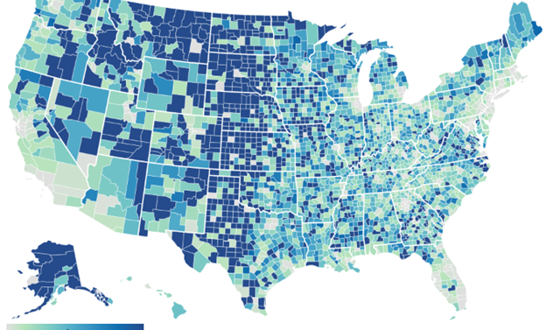
Case: "Equitable Access and Reimbursement for Pharmacy-Based Services" (UWash)
Pharmacy Deserts
Impact on Vaccination Rates
Reimbursement Challenges

Slide 12
Breakout Groups
Discuss case with prompt
Apply to real world setting
Broken up into Teams groups for 7 minutes

Slide 13
Discussion
Based on the Case, how do reimbursement policies influence the availability and quality of healthcare services provided by community pharmacies, particularly in underserved areas?
Compare fee-for-service and value-based reimbursement models. Which model you think best supports community pharmacy goals, like improving patient adherence, managing chronic diseases, and maintaining financial stability? Consider the potential challenges and benefits of each model for both patients and pharmacies. Which model would you advocate for in your own future practice, and why?

Slide 14
Role of Pharmacists in Navigating Reimbursement
Advocating for Fair Reimbursement
Effective Communication with Payers
Educating Patients on Coverage Options
Tracking and Documenting Outcomes
Adapting Services to Meet Reimbursement Policies
Reflection: What is one way pharmacists can improve reimbursement systems?

Slide 15
Key Takeaways
Reimbursement Models
MTM as a Service
Role of Pharmacists
Impact on Care and Viability
Raise Hand or Teams Chat: Questions?

